Slide 1
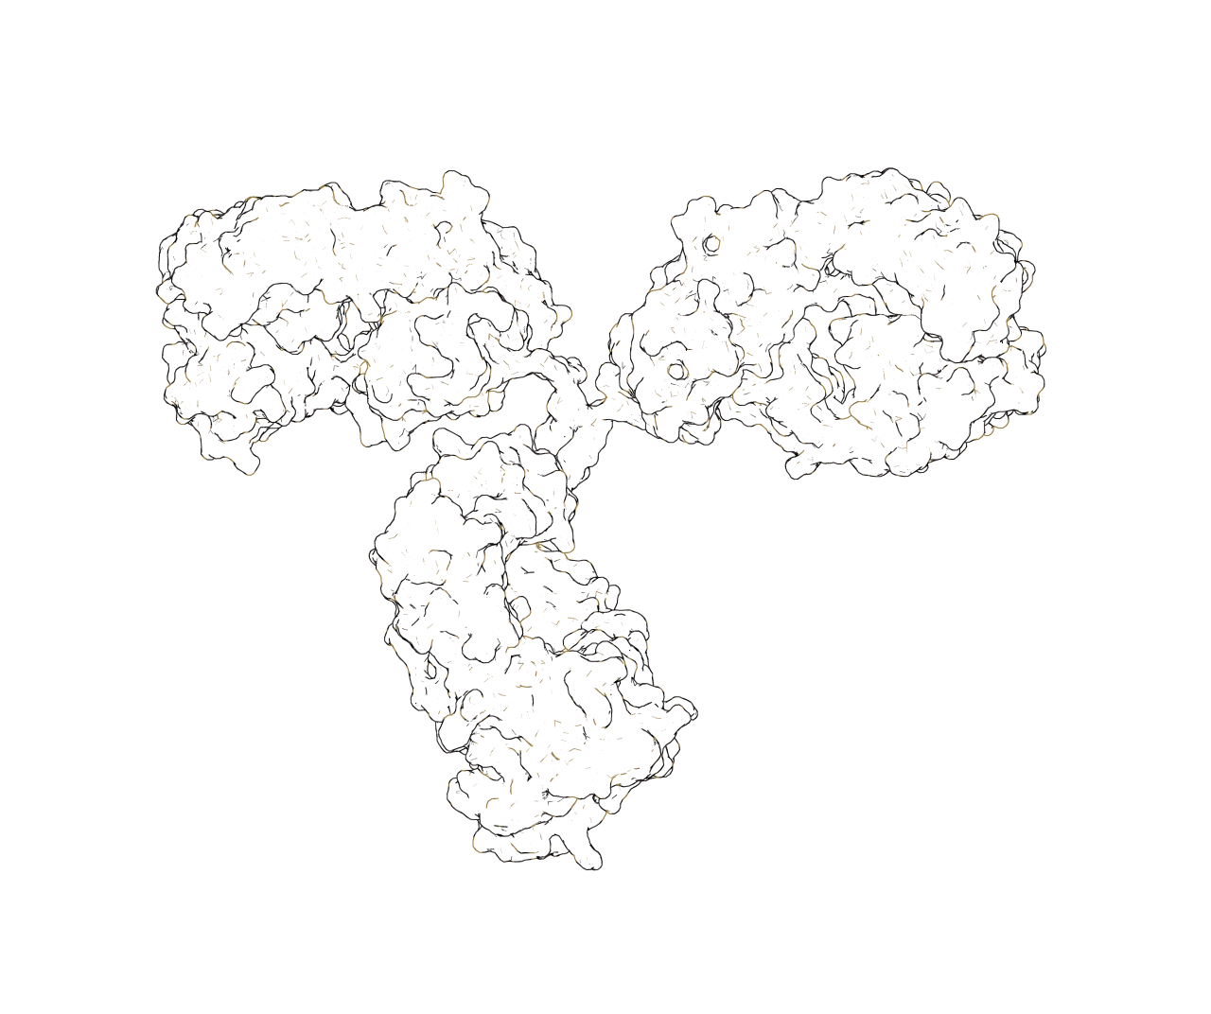

Generative language modeling for antibody design
Jeffrey A. Ruffolo, Richard W. Shuai, Jeffrey J. Gray

Slide 2
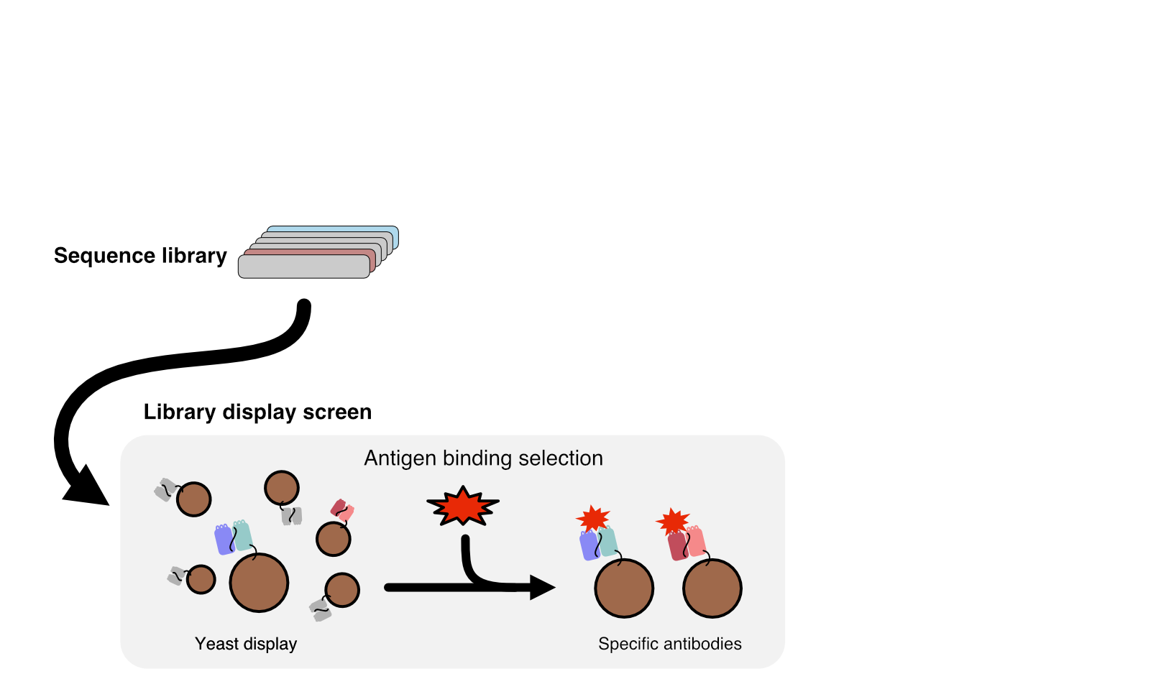
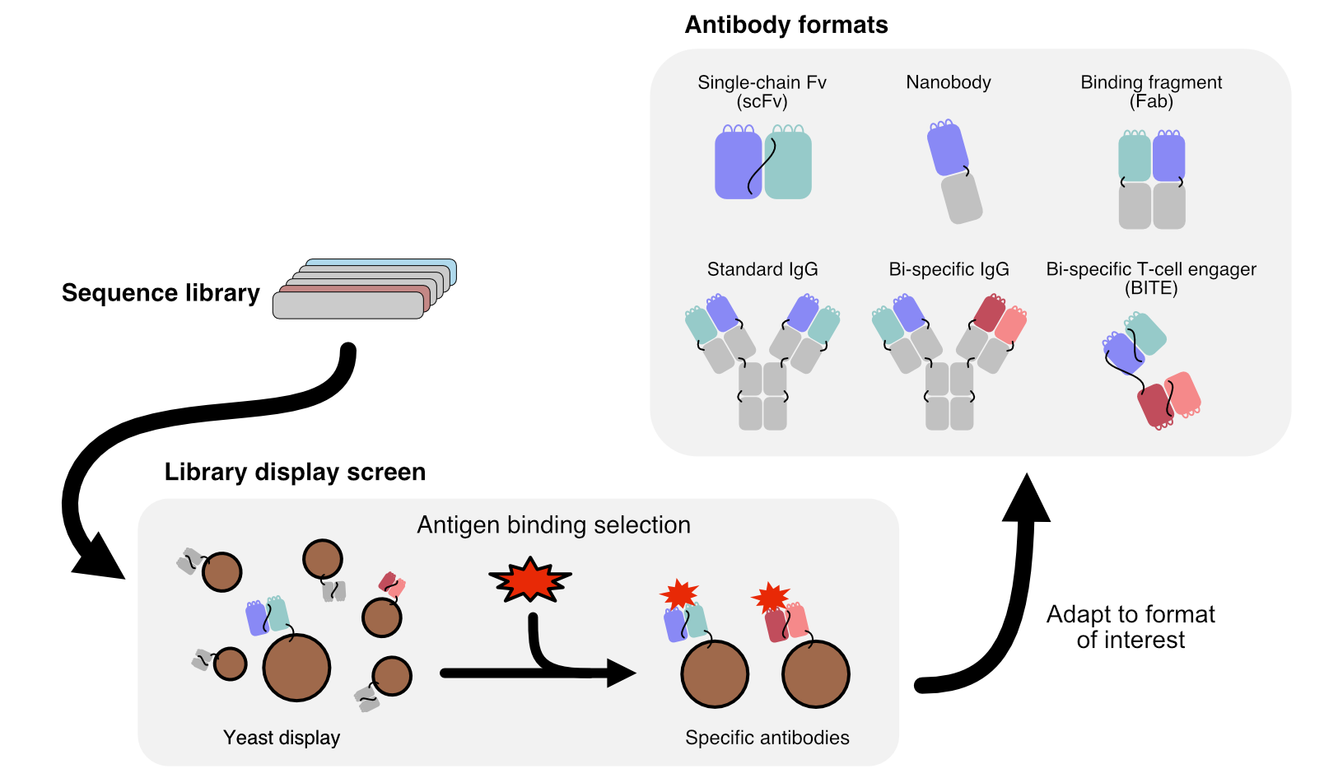
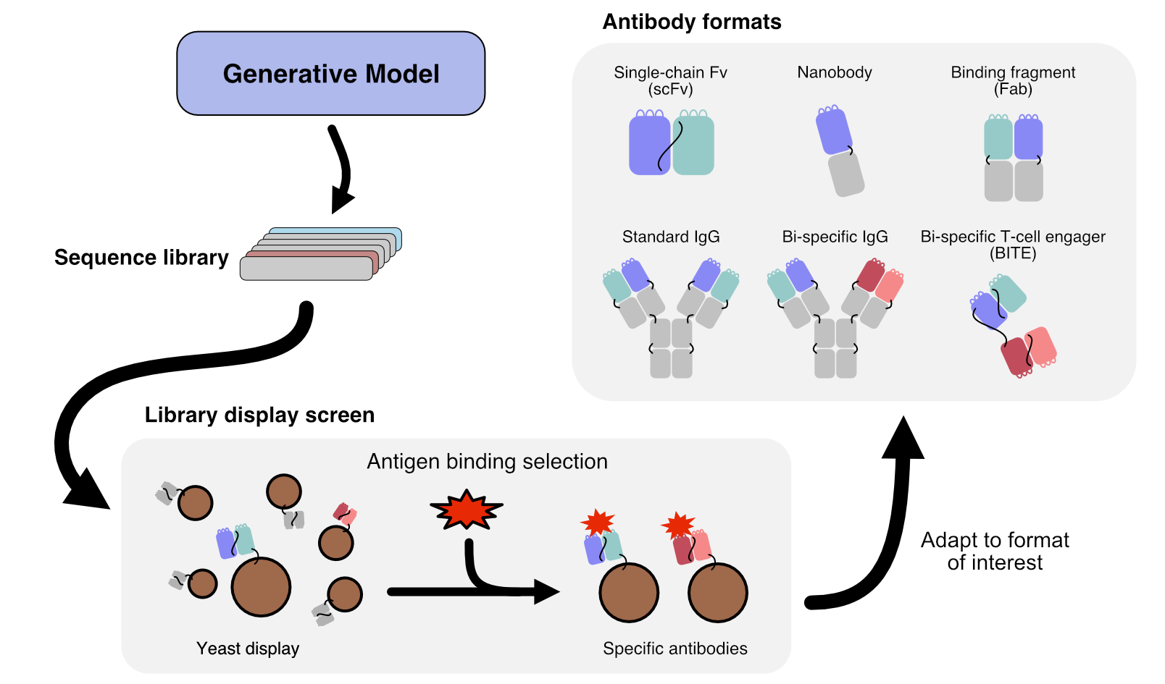
Sequence libraries are a powerful tool for antibody discovery

Slide 3
Overview
Antibody-specific generative language model
Controllable generation of full-length sequences
Infilled therapeutic antibody libraries
Likelihood estimation and future lessons

Slide 4
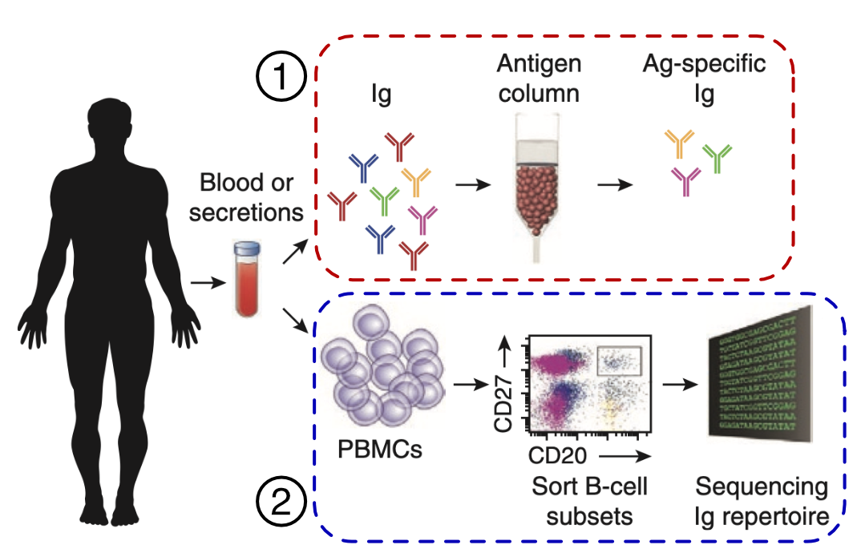
Immune repertoire samples provide a snapshot of an individual’s antibody sequences
Adapted from Georgiou, et al., Nature Biotech. (2014)

Slide 5
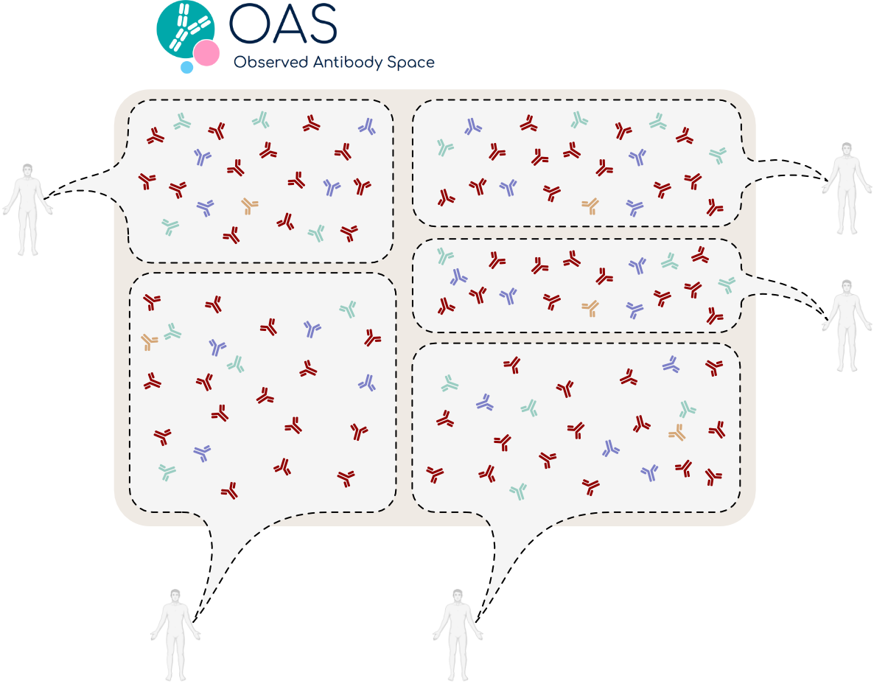
Observed Antibody Space collects sequences from repertoire sequencing studies
Kovaltsuk, et al., J. Immunology (2018)

Slide 6
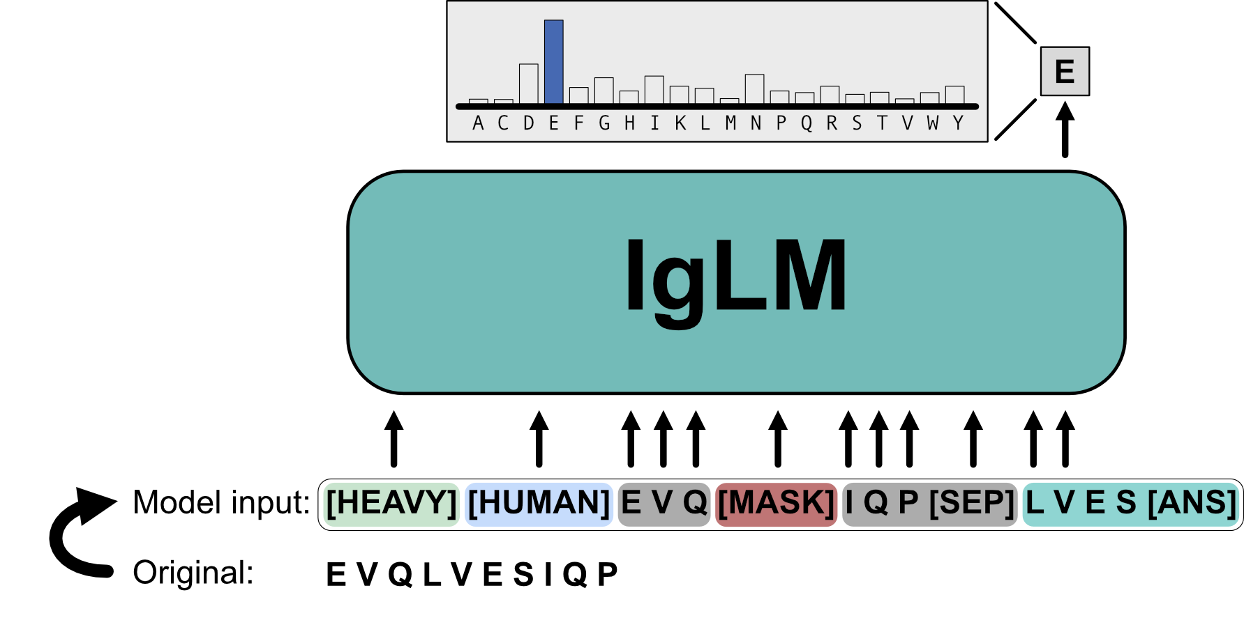
IgLM formulates antibody generation as a sequence infilling task
Shuai and Ruffolo et al., bioRxiv (2021)

Slide 7
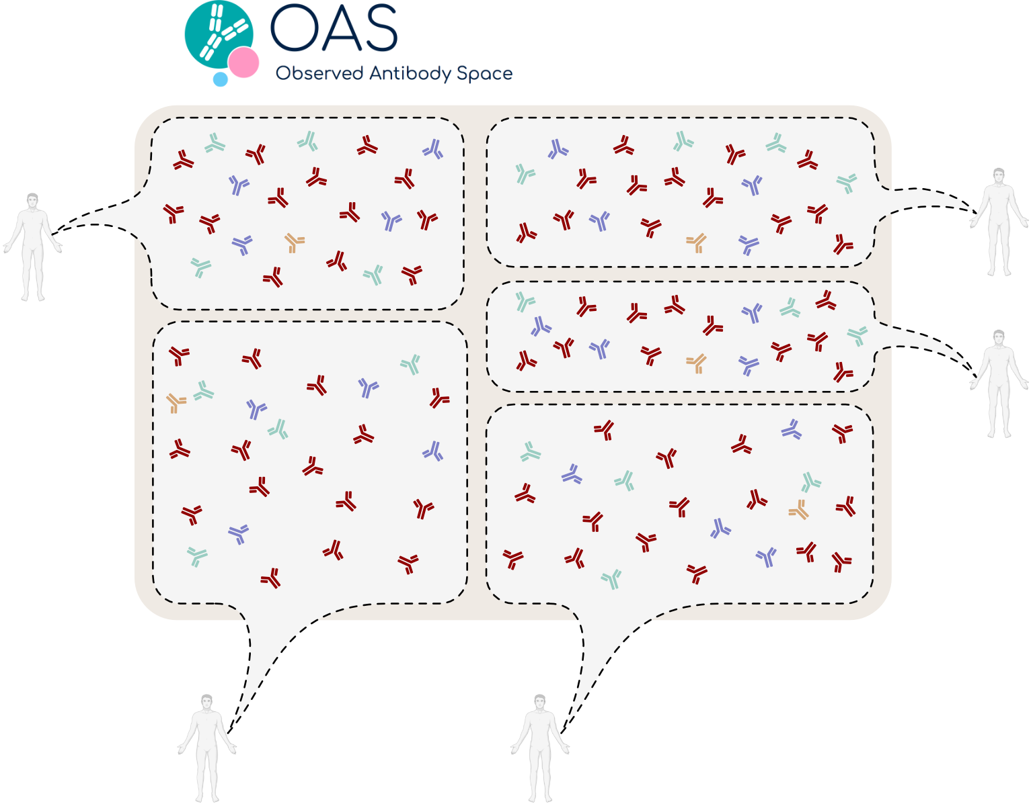
IgLM is trained on 558M natural antibody sequences from OAS
Clustered to 588M sequences
at 95% sequence identity
Shuai and Ruffolo et al., bioRxiv (2021)

Slide 8
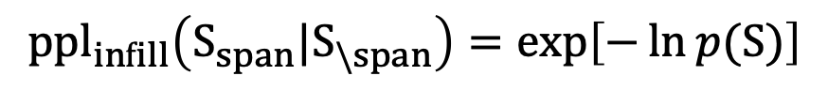
Increasing model capacity enables IgLM to better capture distribution of antibody sequences
$${ppl}_{infill}\left(S_{span}|S_{\backslash span}\right)=exp\left[−\ln{p(S)}\right]$$
Shuai and Ruffolo et al., bioRxiv (2021)

Slide 9
Perplexity varies considerably by species
Shuai and Ruffolo et al., bioRxiv (2021)

Slide 10
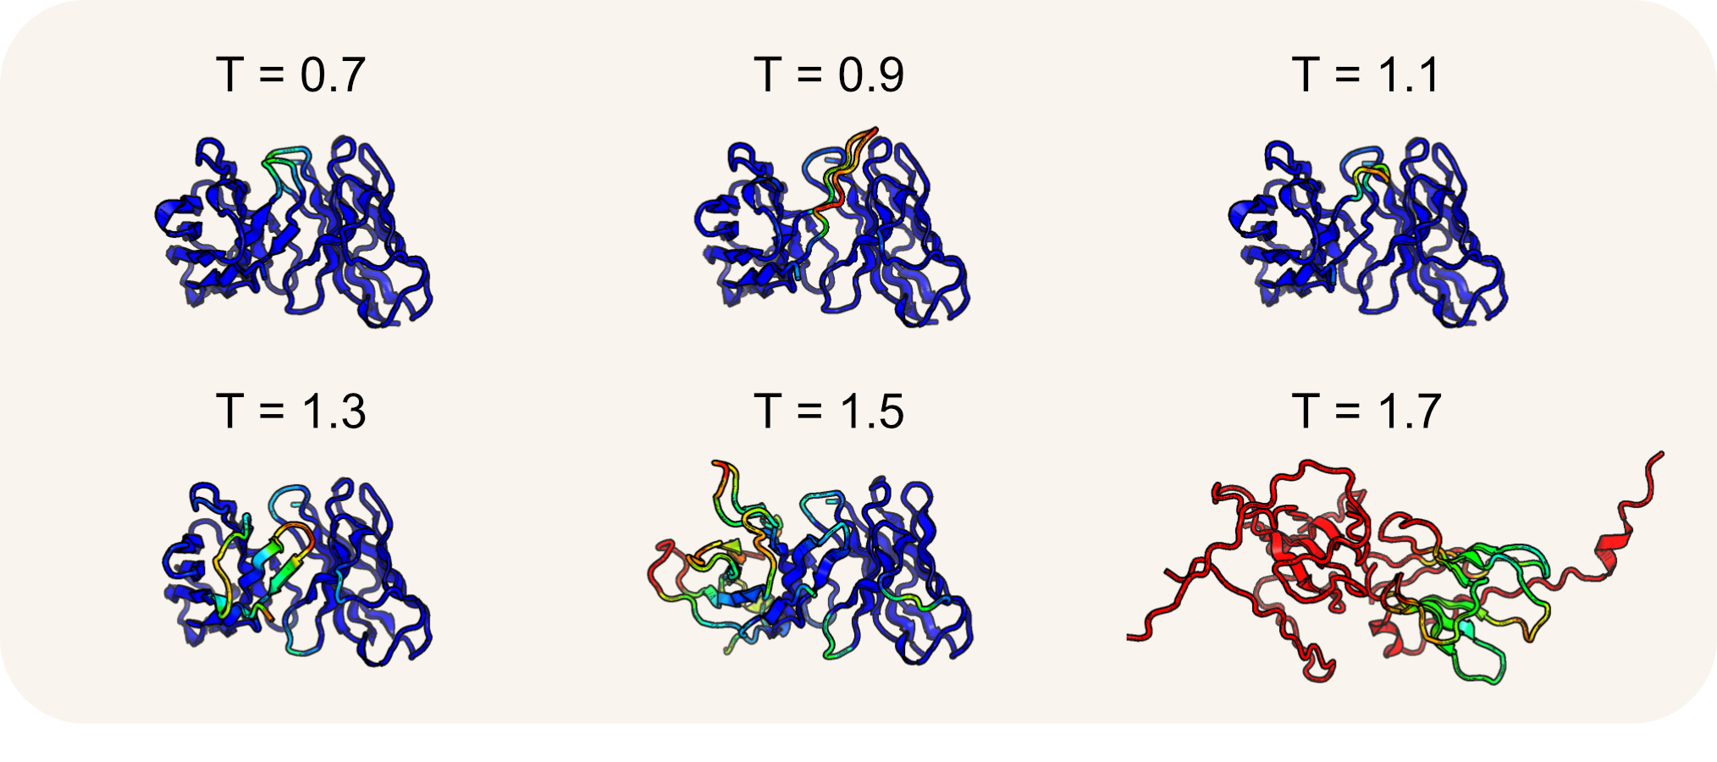
Increasing sampling temperature too high leads to degradation of generated sequences
Mirdita et al., Nature Methods (2022); Jumper et al., Nature (2021); Shuai and Ruffolo et al., bioRxiv (2021)

Slide 11
Overview
Antibody-specific generative language model
Controllable generation of full-length sequences
Infilled therapeutic antibody libraries
Likelihood estimation and future lessons

Slide 12
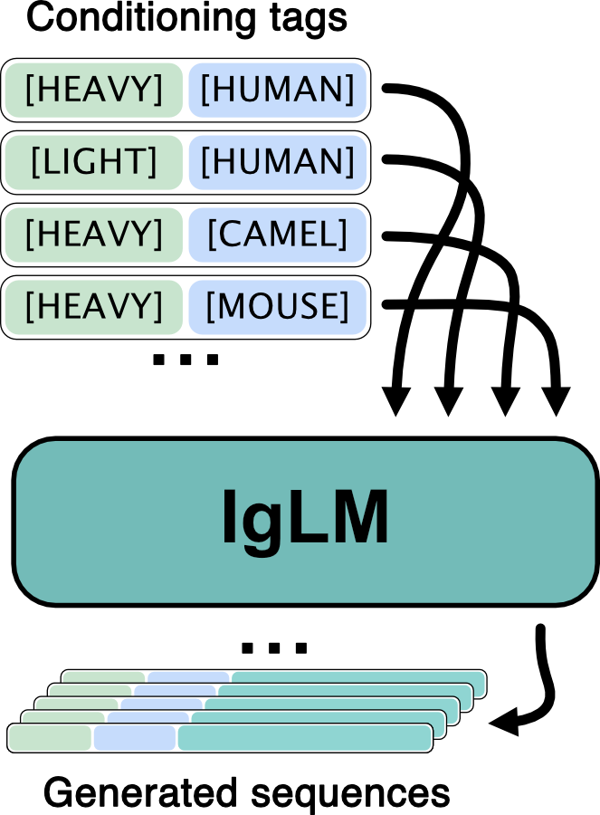
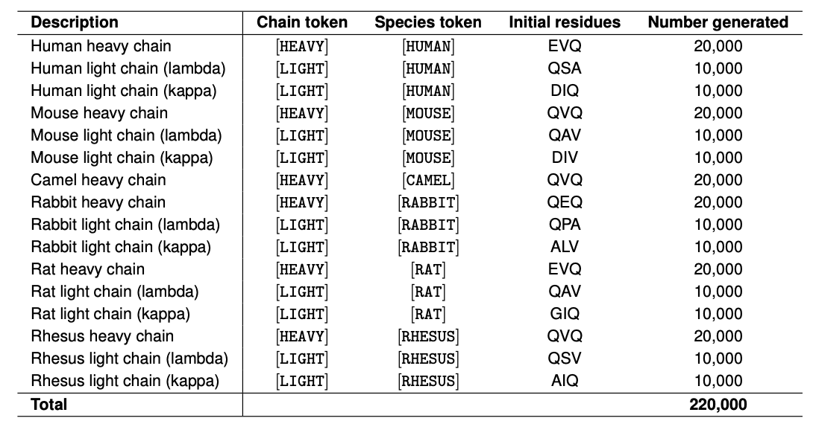
Controllable generation of chain- and species-specific sequences
Shuai and Ruffolo et al., bioRxiv (2021)

Slide 13
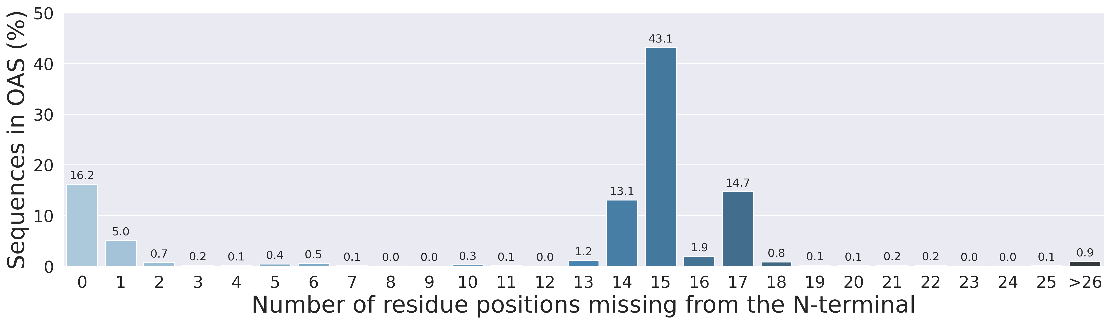
One small problem… OAS sequences are often truncated at the N-terminus
Olsen et al., Bioinformatics Advances (2022)

Slide 14
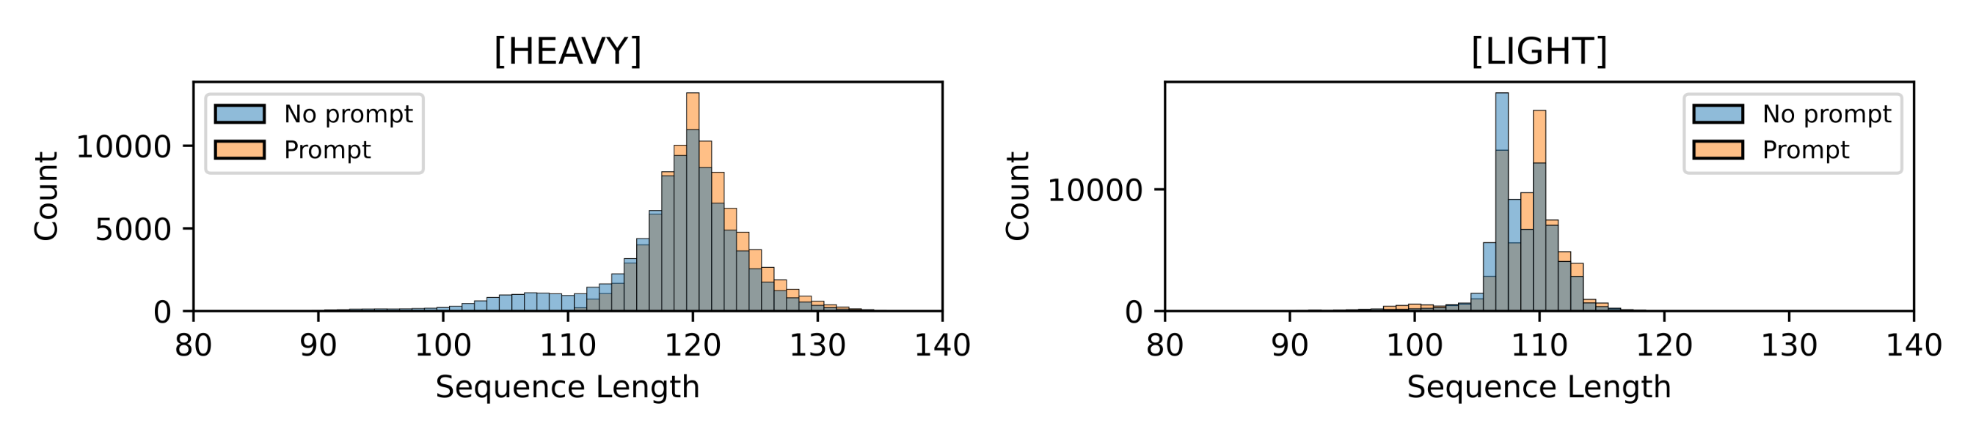
Providing initial three residues enables generation of complete sequences
Shuai and Ruffolo et al., bioRxiv (2021)

Slide 15
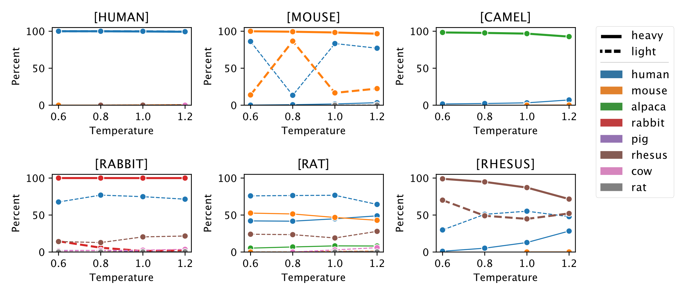
IgLM adheres to species conditioning for heavy chains, but is less consistent for light chains
Shuai and Ruffolo et al., bioRxiv (2021)

Slide 16
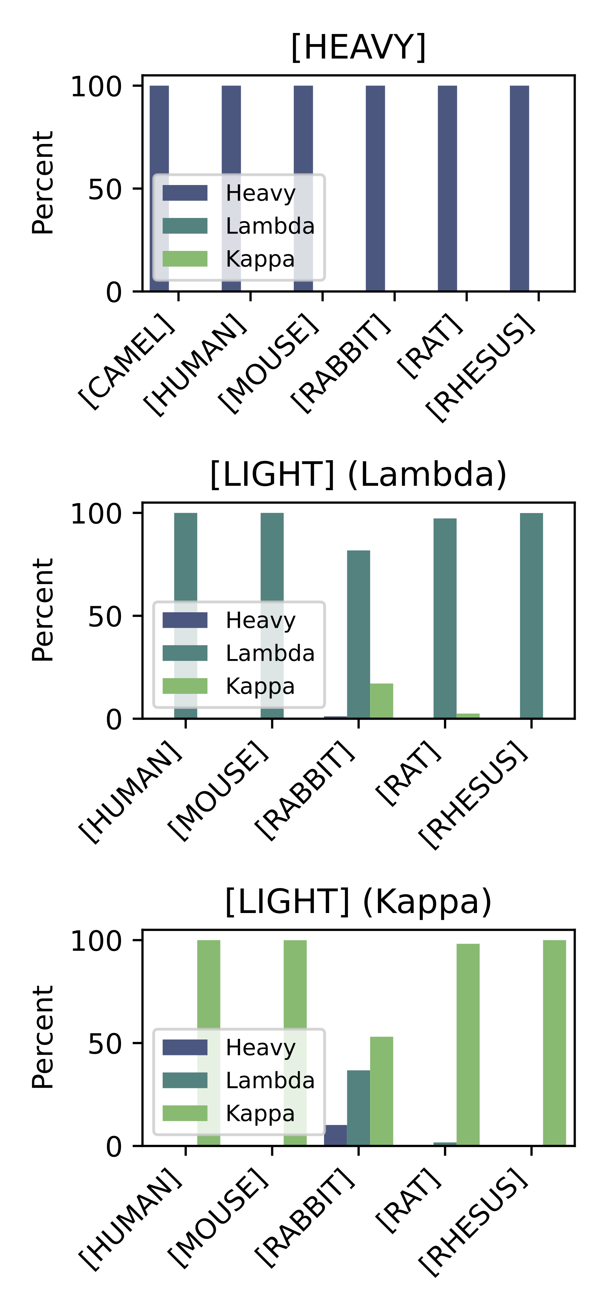
IgLM adheres to chain type conditioning and residue prompting
Shuai and Ruffolo et al., bioRxiv (2021)

Slide 17
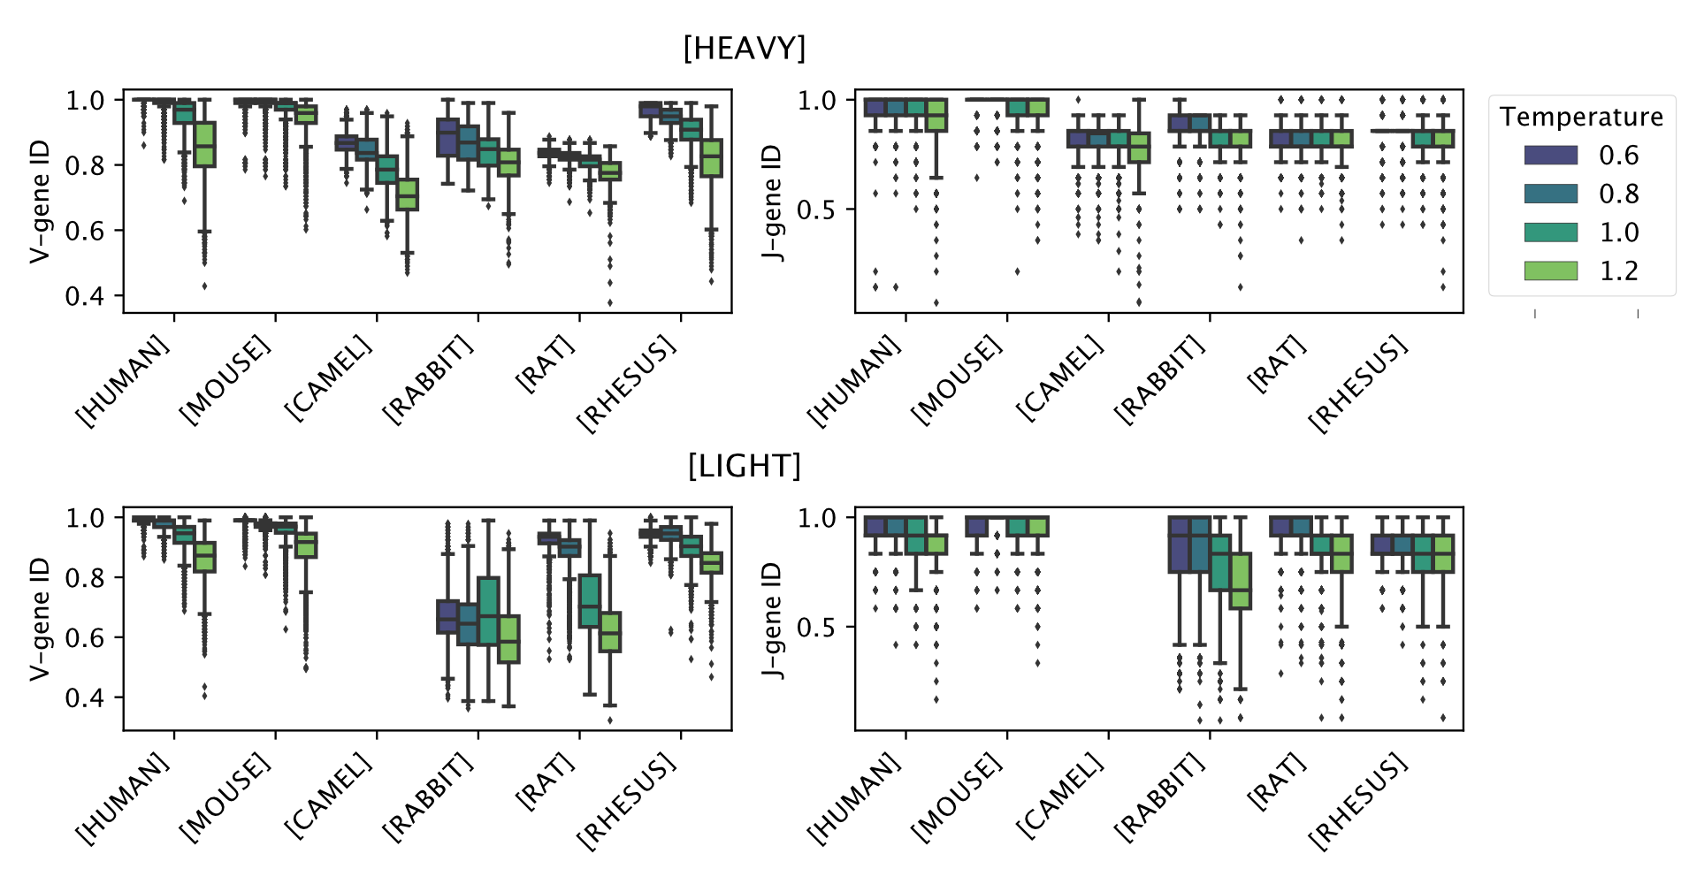
Sampling temperature controls mutational load
Shuai and Ruffolo et al., bioRxiv (2021)

Slide 18
Overview
Antibody-specific generative language model
Controllable generation of full-length sequences
Infilled therapeutic antibody libraries
Likelihood estimation and future lessons

Slide 19
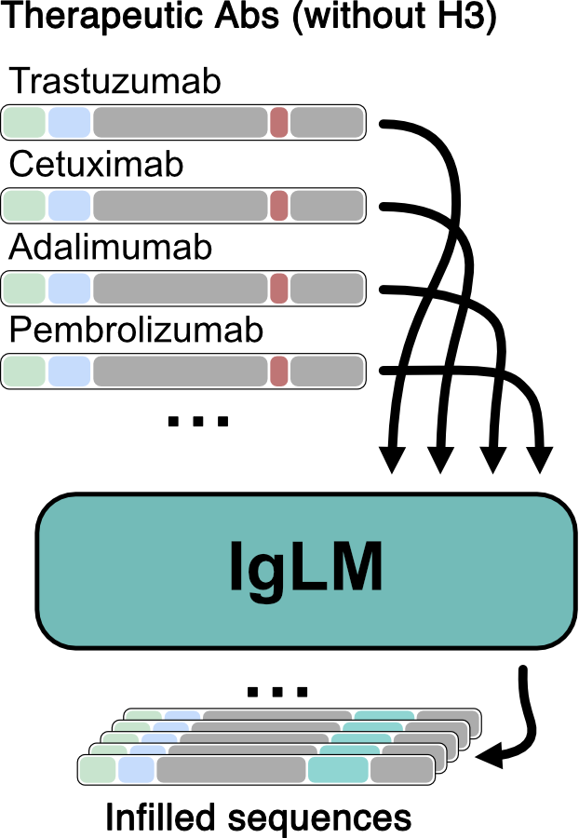
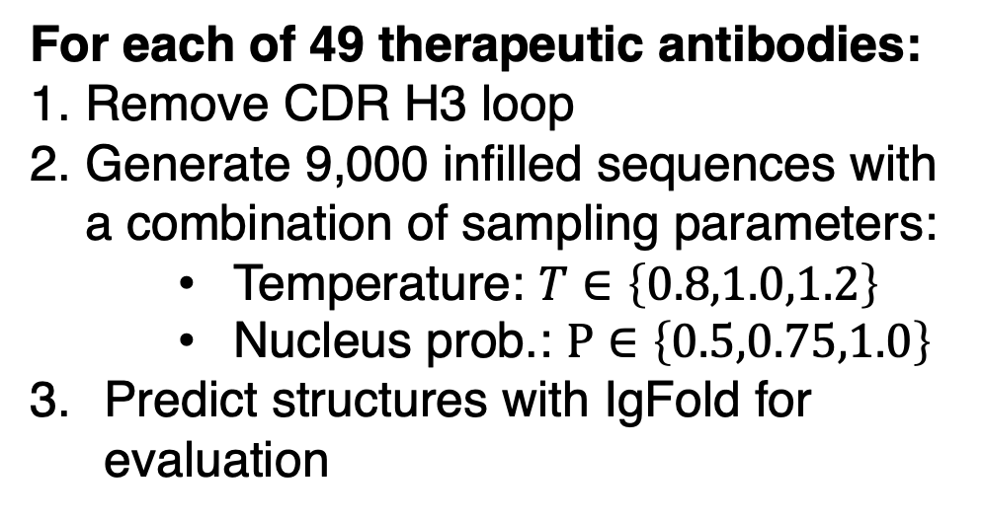
Generation of therapeutic libraries by CDR loop infilling
For each of 49 therapeutic antibodies:
Remove CDR H3 loop
Generate 9,000 infilled sequences with a combination of sampling parameters:
Temperature: $T∈\left\{0.8,1.0,1.2\right\}$
Nucleus prob.: $P∈\left\{0.5,0.75,1.0\right\}$
Predict structures with IgFold for evaluation
Shuai and Ruffolo et al., bioRxiv (2021)

Slide 20
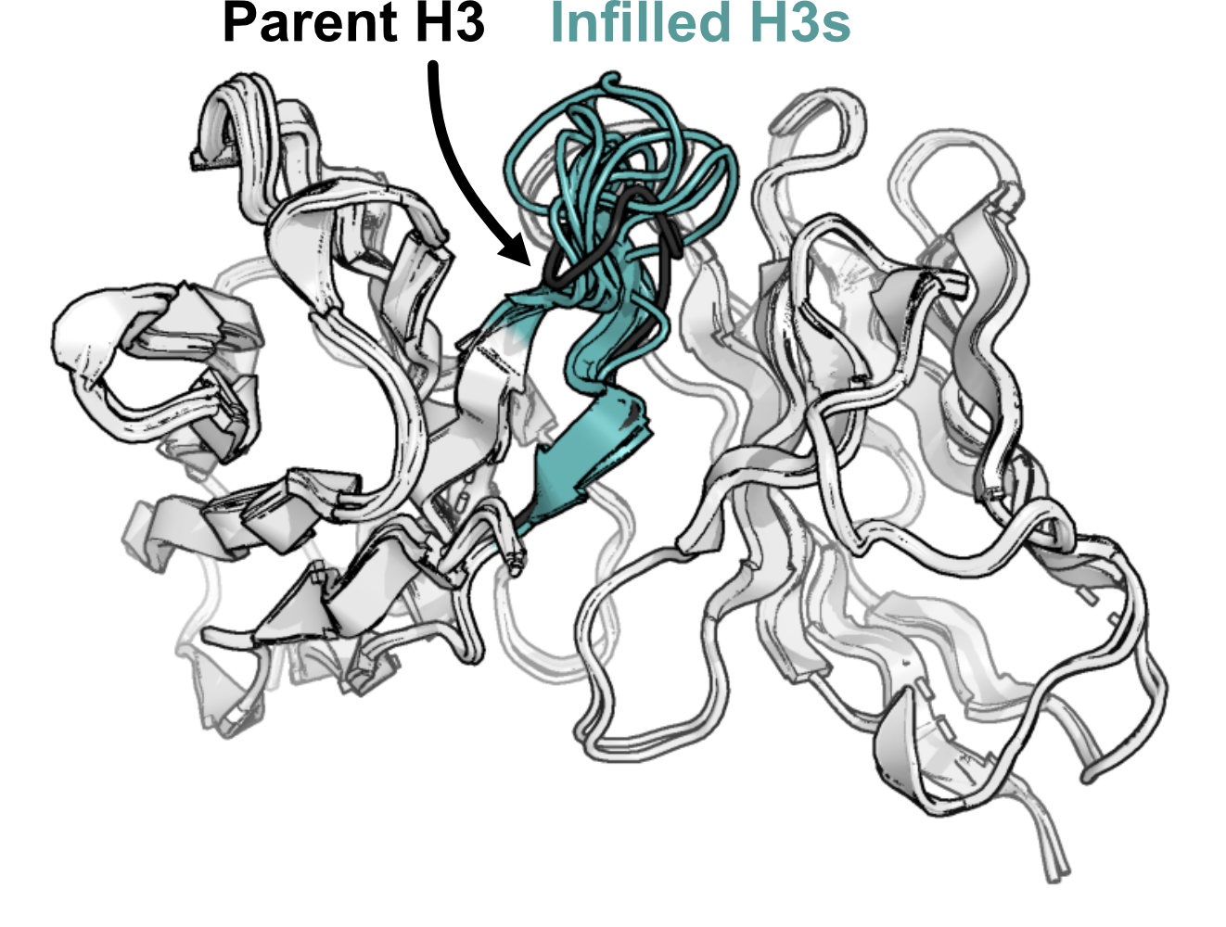
Infilled loop lengths varies by surrounding parent sequence context
Trastuzumab
Shuai and Ruffolo et al., bioRxiv (2021)

Slide 21
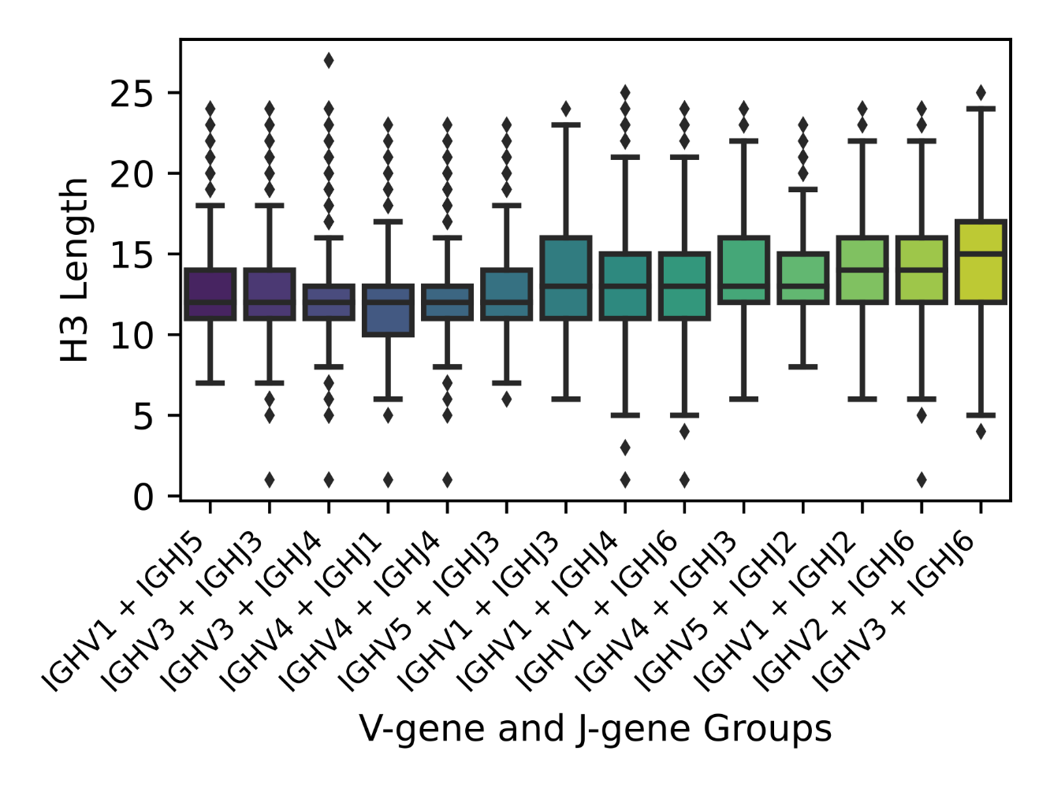
Closest germline V-gene and J-gene groups partially explain infilled loop lengths
Shuai and Ruffolo et al., bioRxiv (2021)

Slide 22
Sampling parameters control diversity of infilled loops
Shuai and Ruffolo et al., bioRxiv (2021)

Slide 23
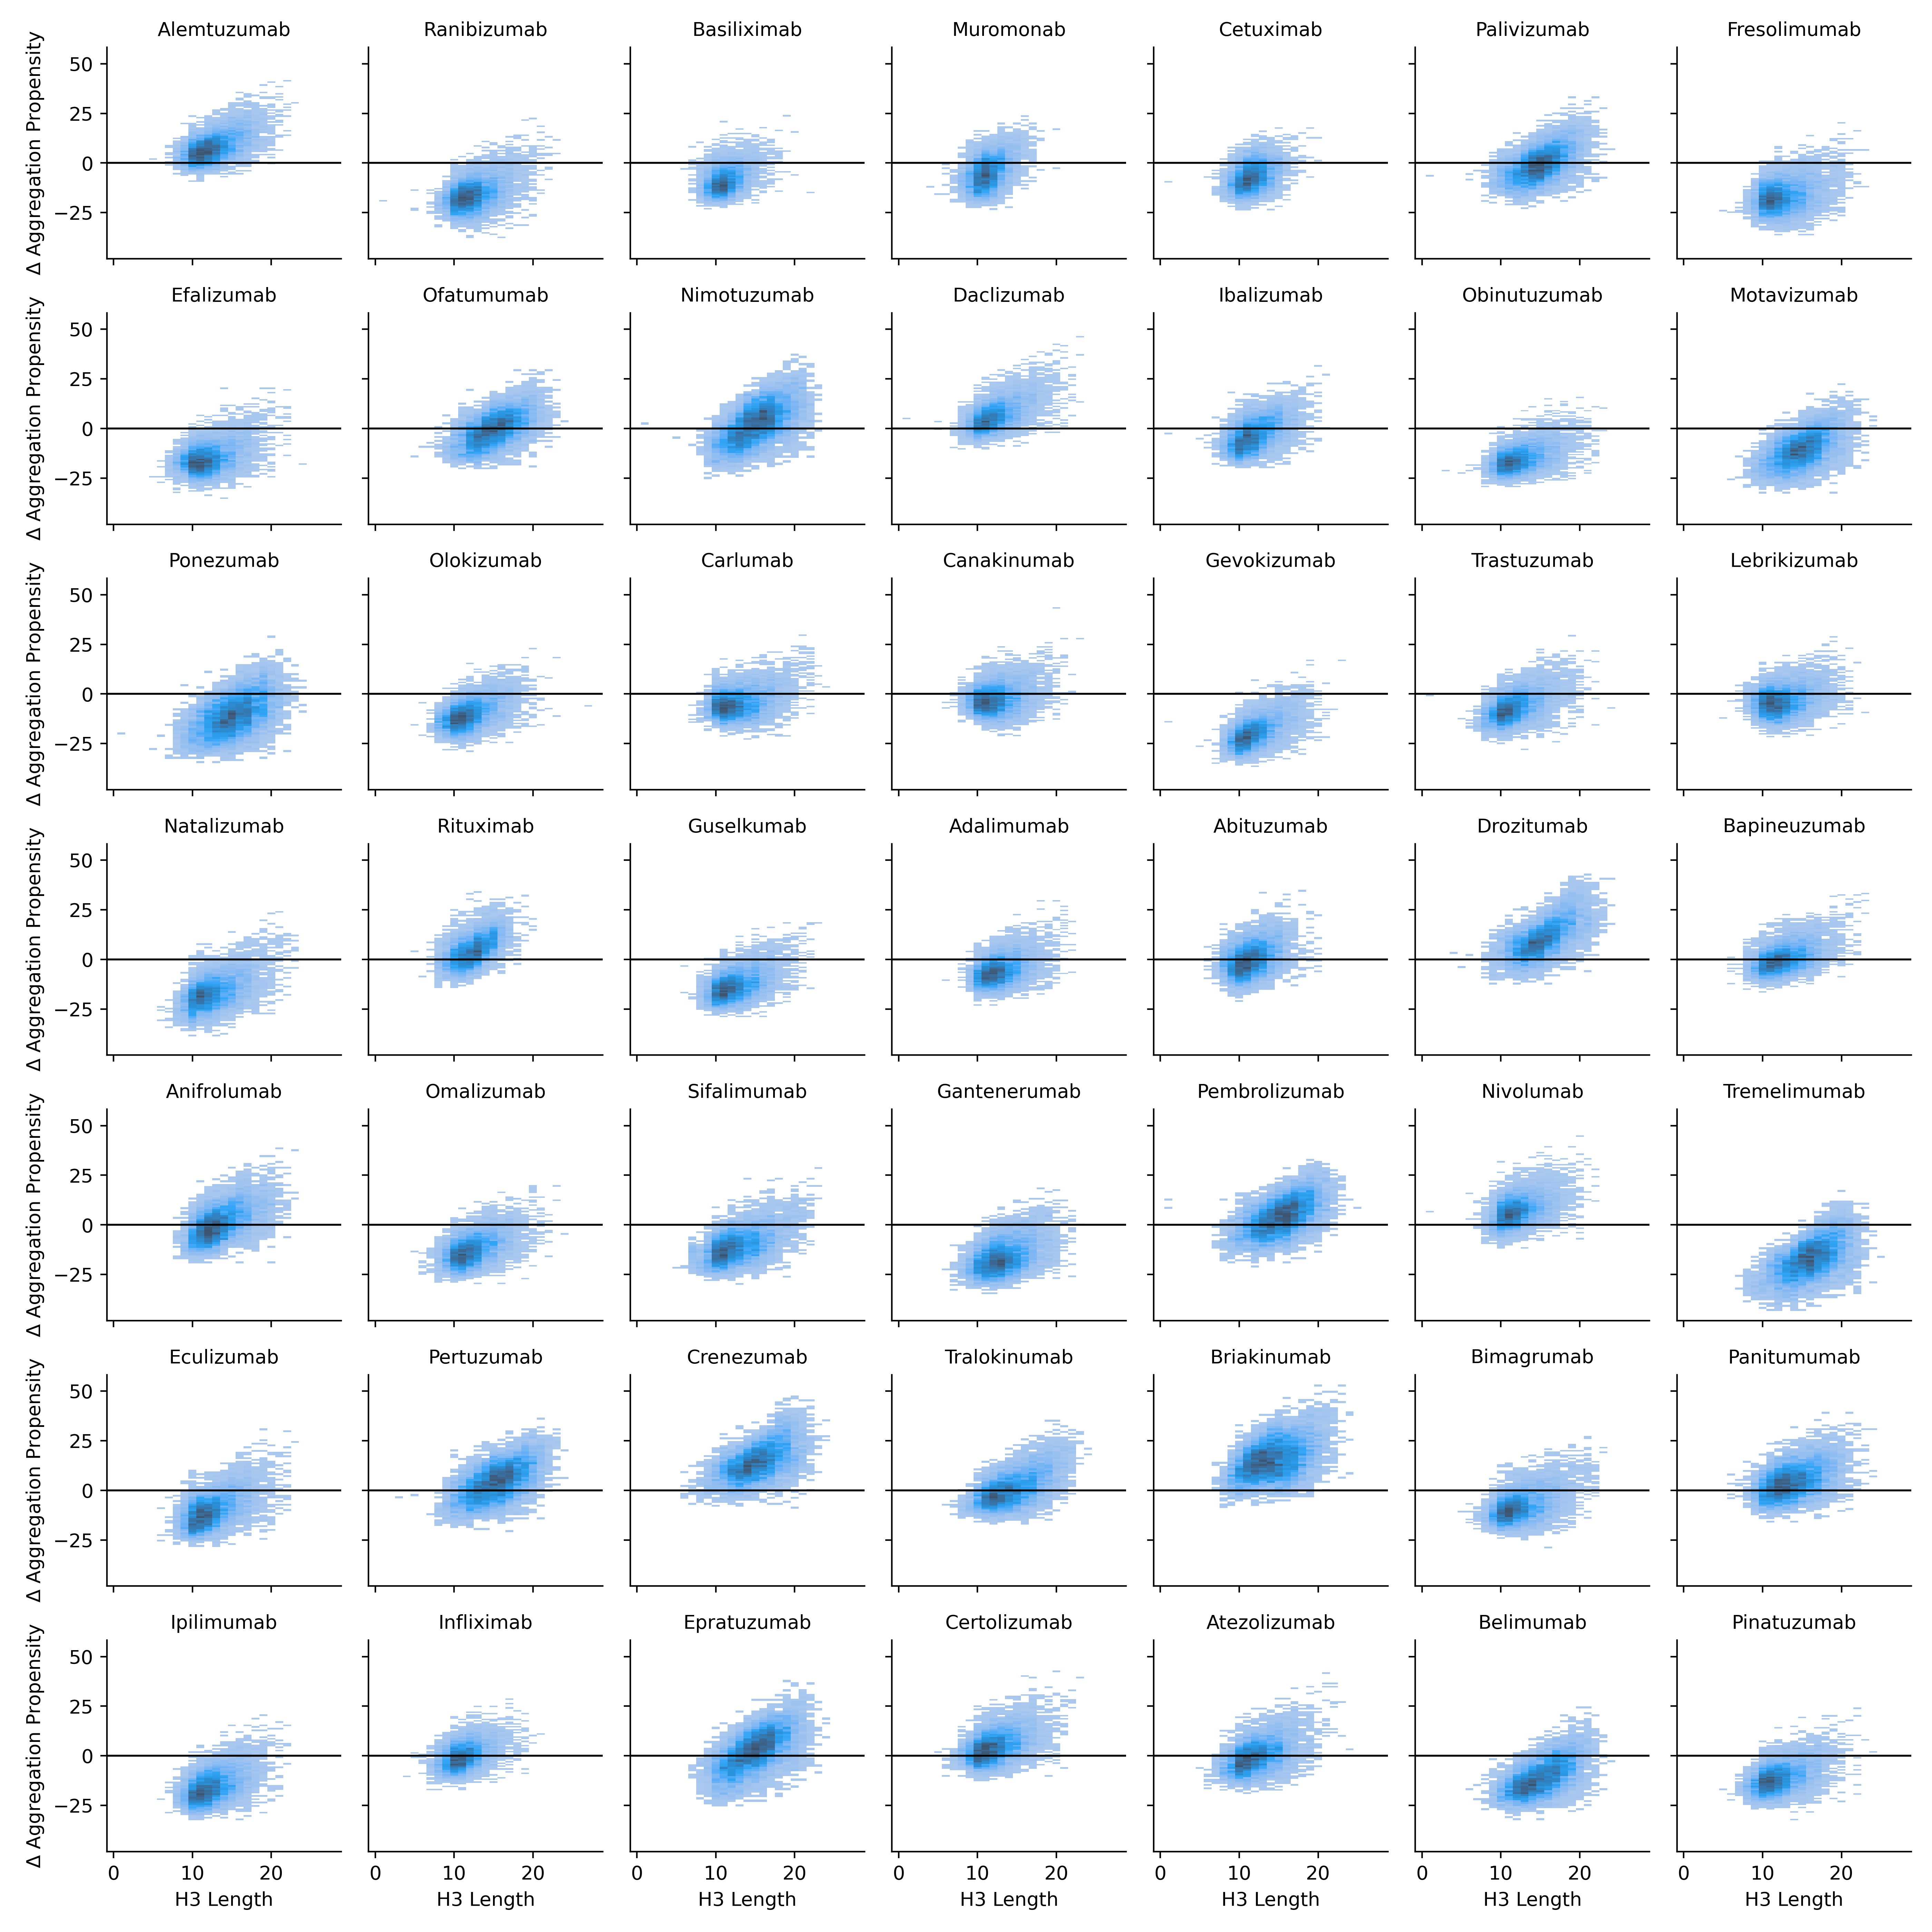
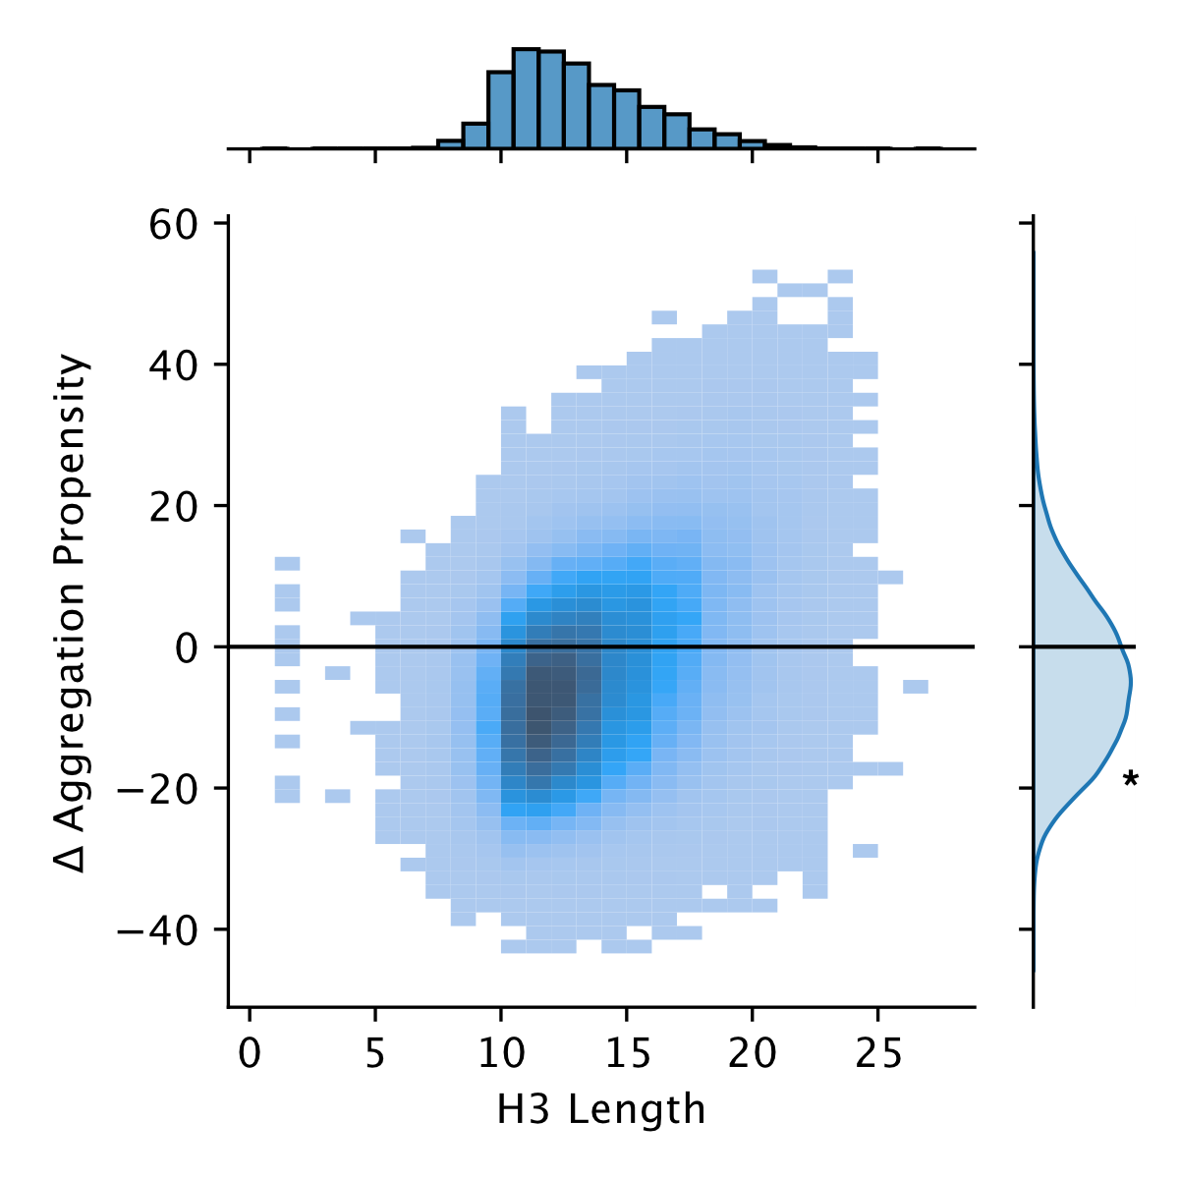
Infilled libraries have lower aggregation propensity than their parent sequences
Shuai and Ruffolo et al., bioRxiv (2021)

Slide 24
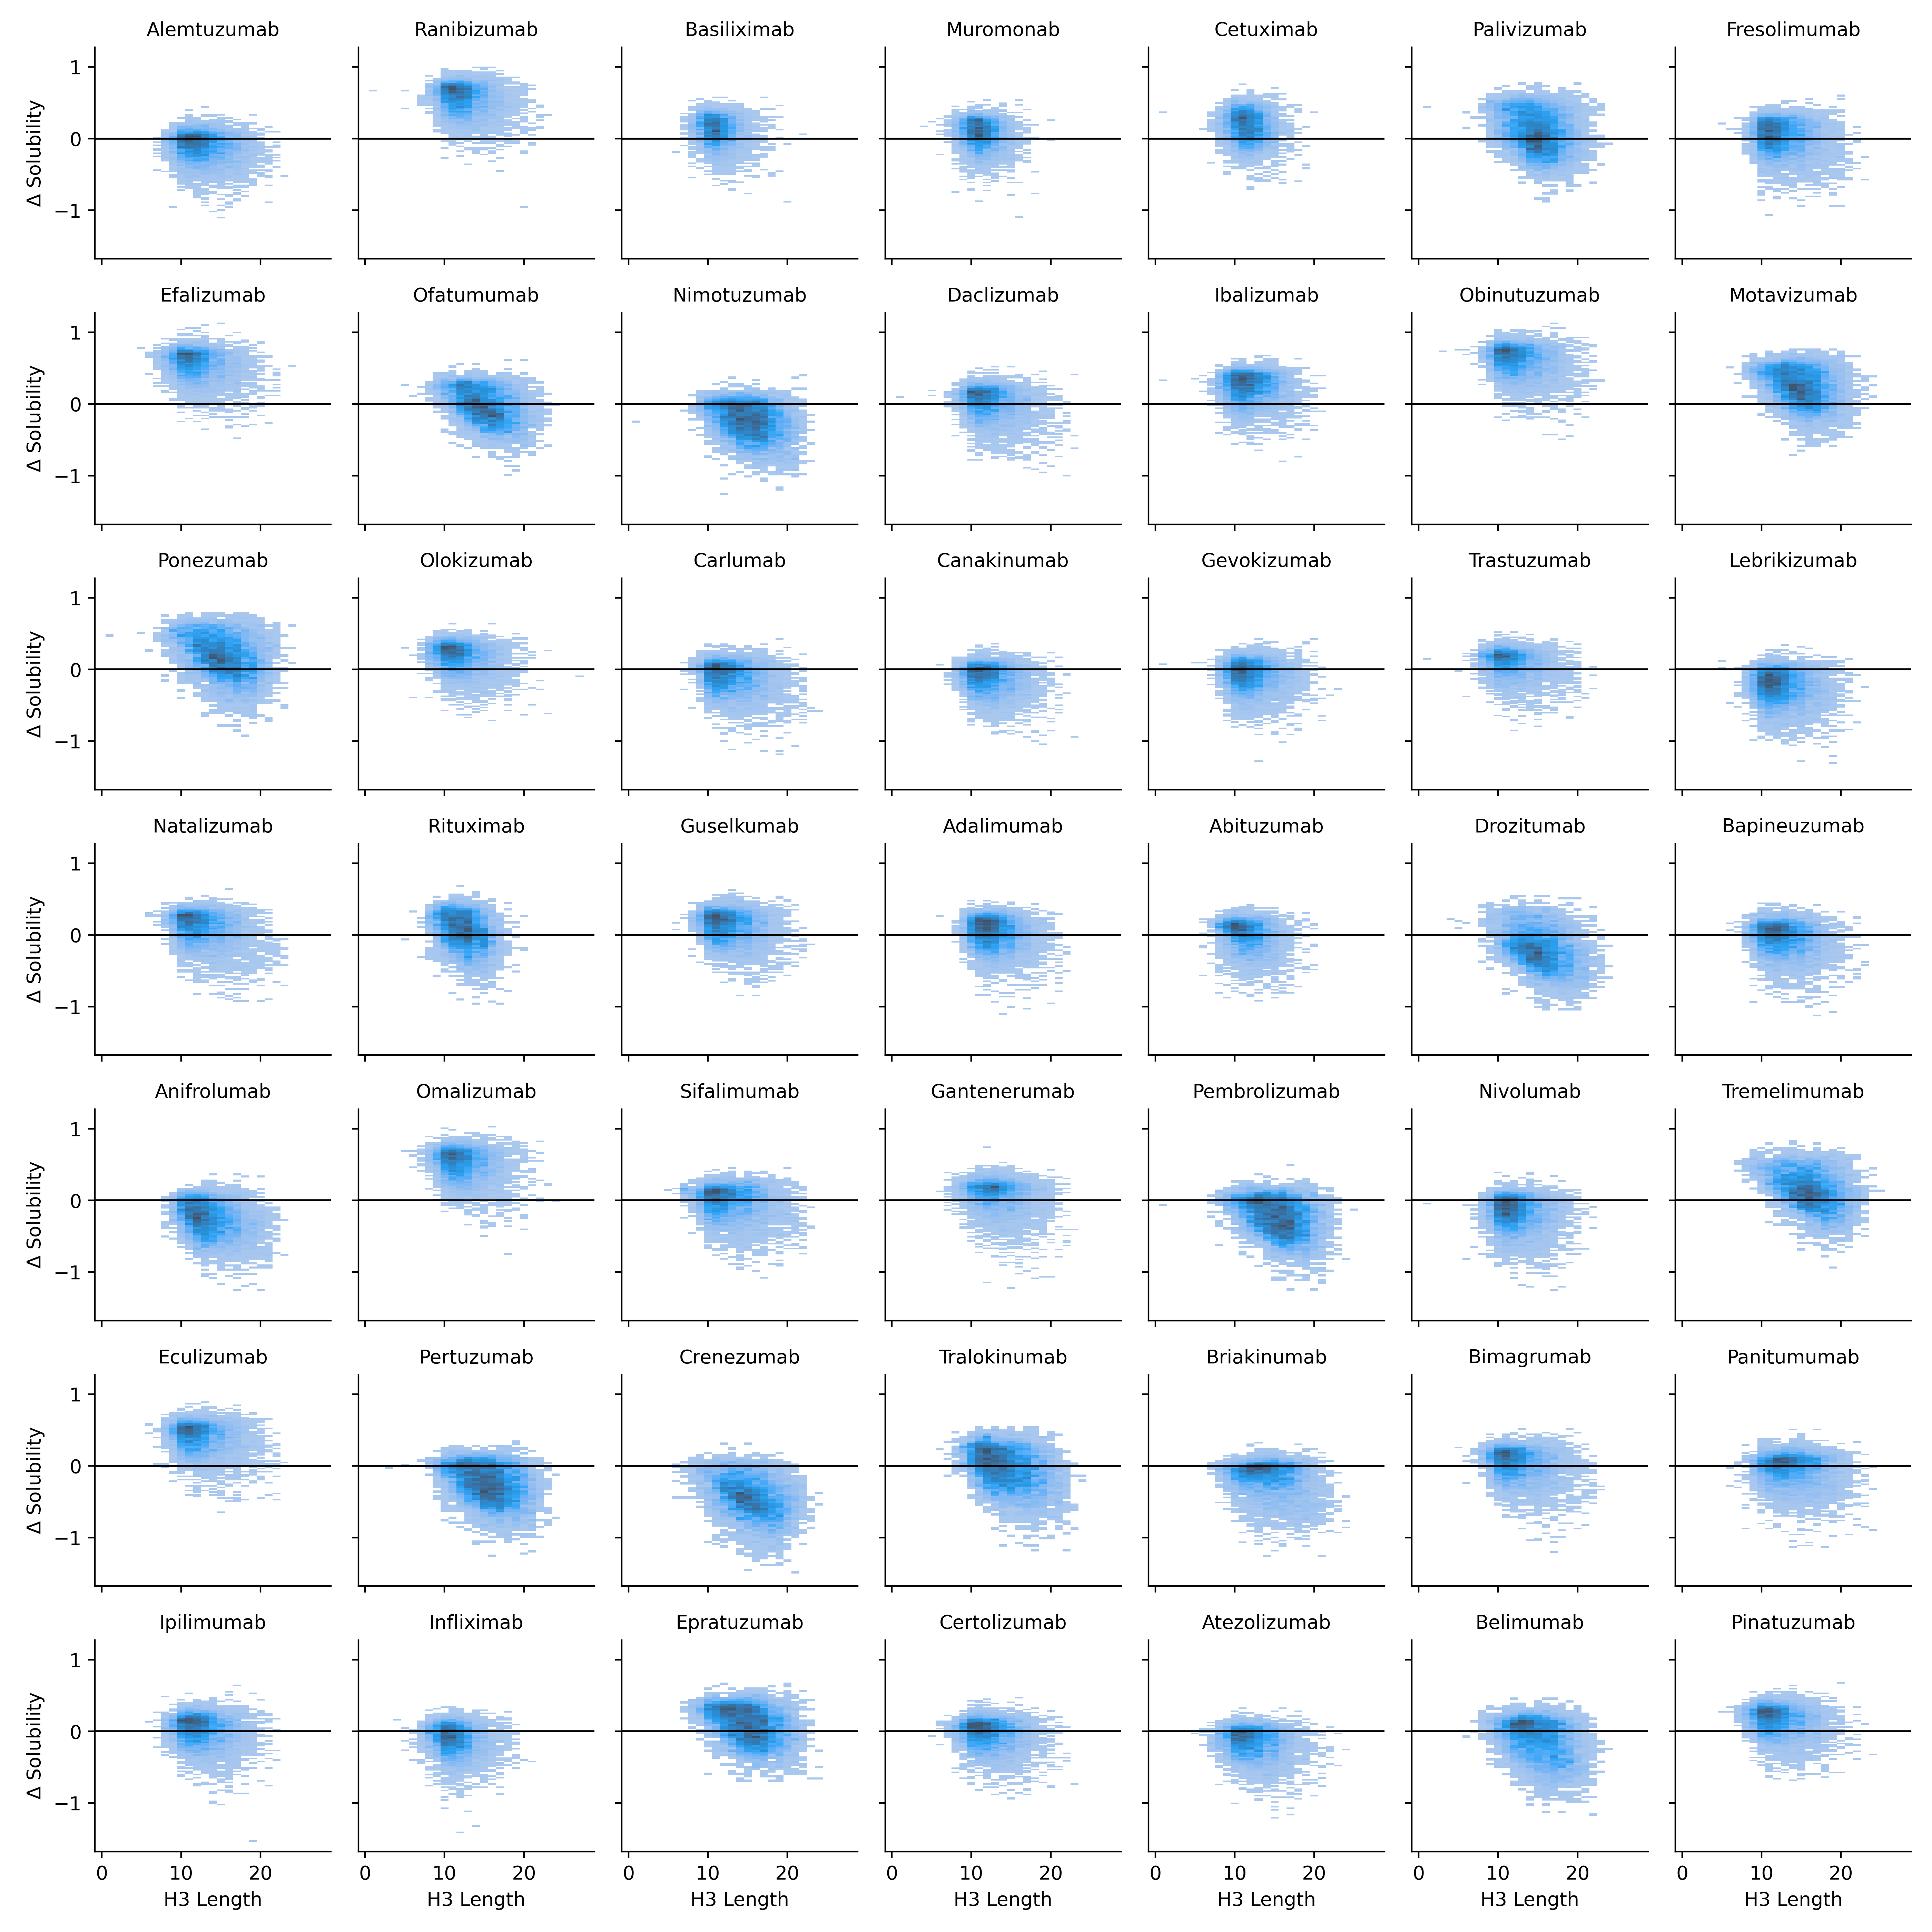
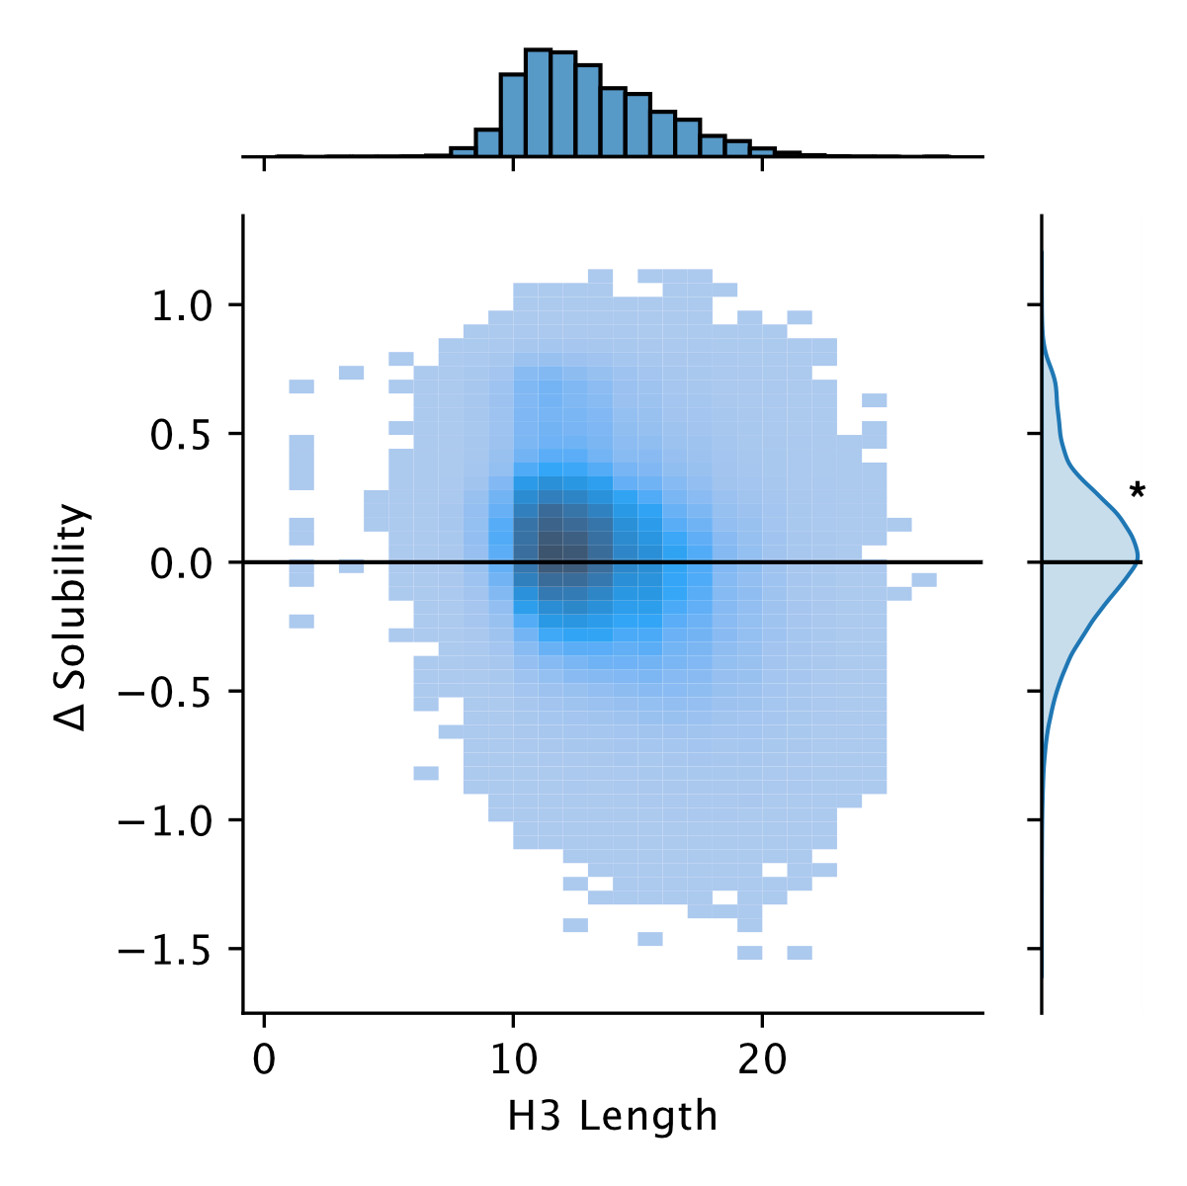
Infilled libraries have higher solubility than their parent sequences
Shuai and Ruffolo et al., bioRxiv (2021)

Slide 25
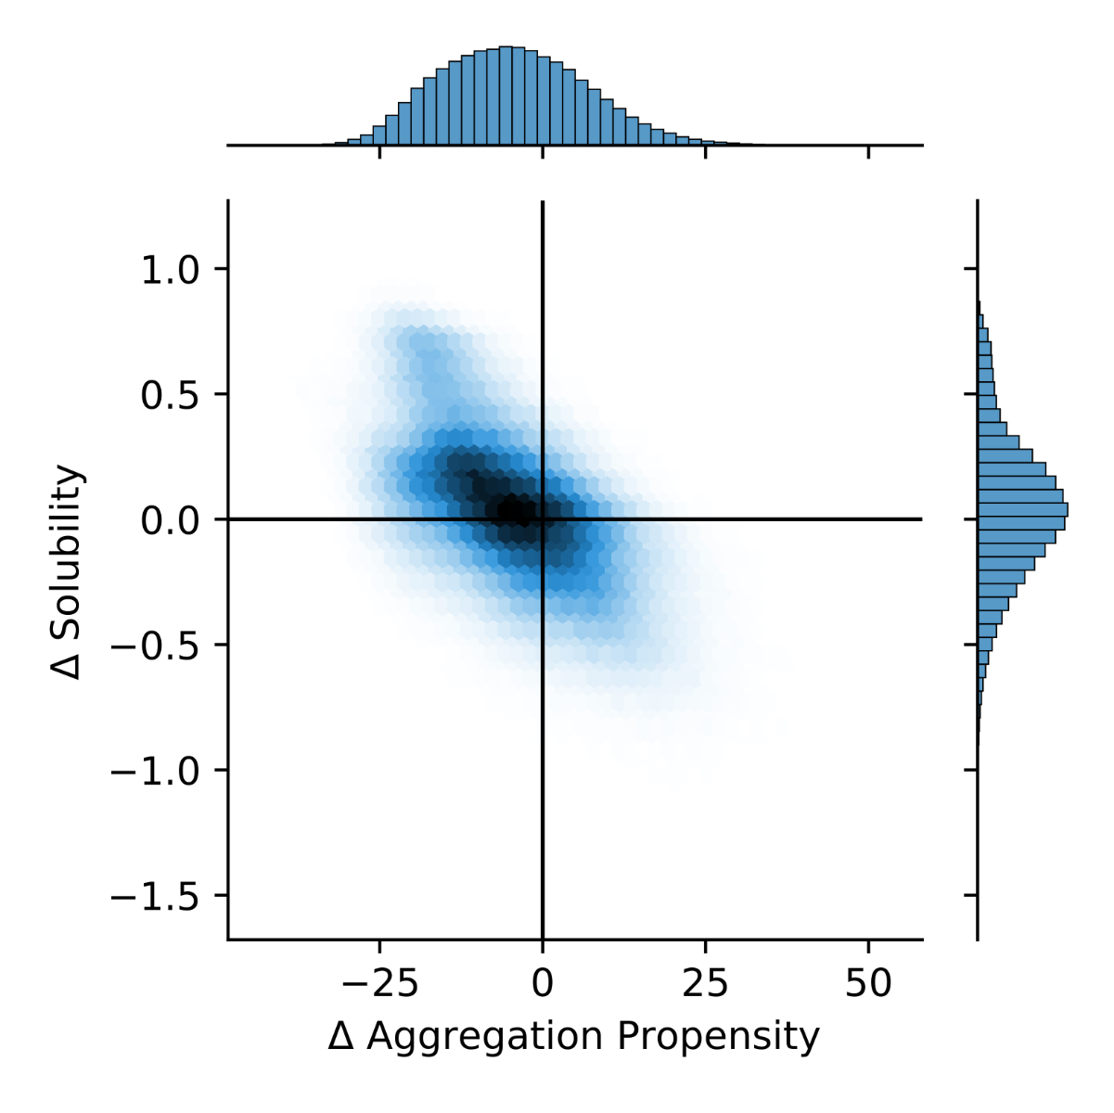
Improvements in aggregation propensity and solubility are correlated amongst library sequences
Shuai and Ruffolo et al., bioRxiv (2021)

Slide 26
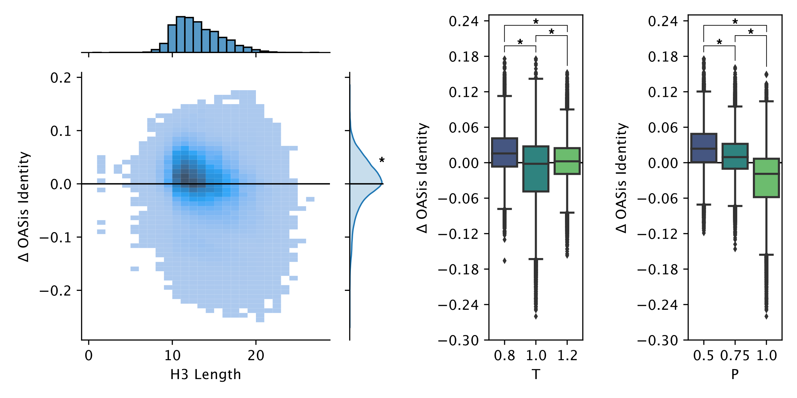
Infilled libraries maintain or improve humanness over parent sequences
Shuai and Ruffolo et al., bioRxiv (2021)

Slide 27
Overview
Antibody-specific generative language model
Controllable generation of full-length sequences
Infilled therapeutic antibody libraries
Likelihood estimation and future lessons

Slide 28
Log likelihoods from IgLM discriminate between human and non-human antibody sequences

Slide 29
IgLM is a state-of-the-art classifier of human sequences

Slide 30
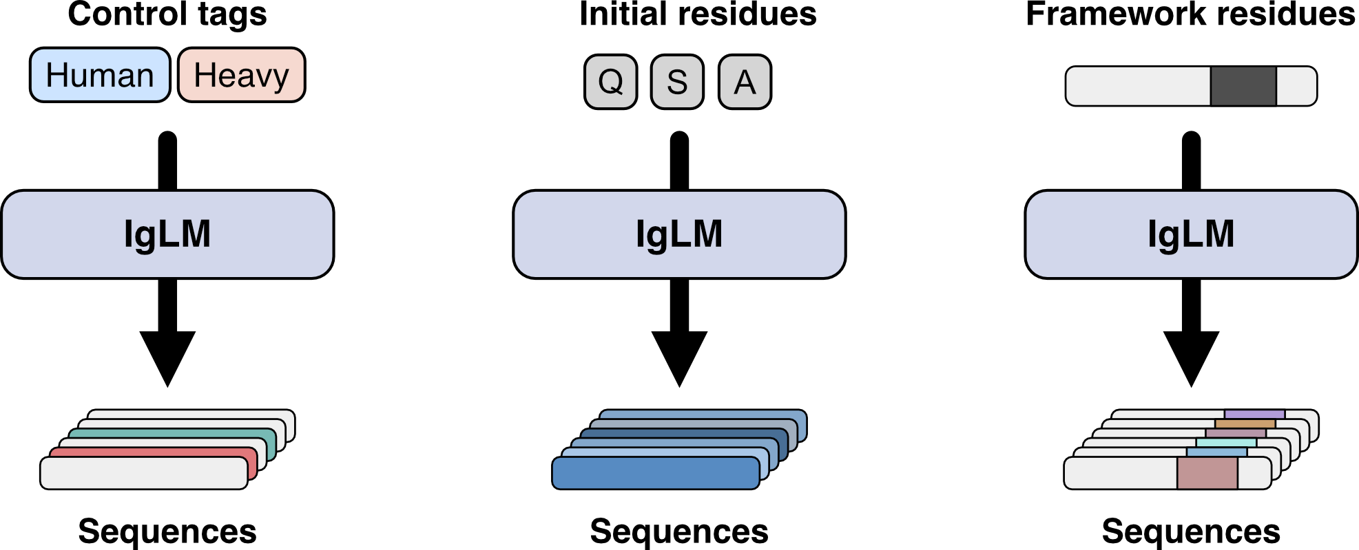
Generative language modeling for antibody design
Conditional generation of antibody sequences
Prompt-guided sequence generation
Targeted CDR loop diversification
Shuai and Ruffolo et al., bioRxiv (2022)

Slide 31
Acknowledgements
Prof. Jeffrey Gray
Prof. Jeremias Sulam
Dr. Sai Pooja Mahajan
Dr. Sudhanshu Shanker
Dr. Rahel Frick
Dr. Rituparna Samanta
Morgan Nance
Ameya Harmalkar
Lee-Shin Chu
Sam Canner
Michael Chungyoun
Fatima Talib
Savannah Speir
Richard Shuai

